Slide 1


Serious Driving
Darren Griffiths & Kamil Witonski present

Slide 2

What Is Serious Driving?
An Educational Game
Rules of The Road
Highway Code
Typical Procedures

Slide 3

But, Why?
Reduce The Magnitude Of Learning To Drive
Make Mistakes To Learn
A Risk Free Environment
Potentially Lowering Incidents
In A Fun 3D Driving Simulator

Slide 4
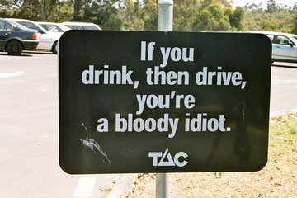
Ok. How?
Freedom = Fun
Drive Around And Explore The Land
Information Boxes Explaining
Road Signs
Crossings
Is it flashing? What it means, what to do.
Manoeuvres
Driving Test Approved
And…

Slide 5
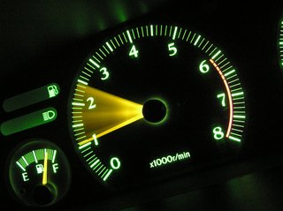
Situations
The Key In Being A Good Driver

Slide 6

Situations
Situations That You May Not Experience During Tests.
Flashing Lights & Sirens
What Colour Means What
What To Do
Crossroads
Motorway Merging
Closed Lanes
And more…

Slide 7
Development Plan

Slide 8





Software
Unity
Coding
Maya
Modelling
Blender
Modelling
Sony Vegas
Audio
Adobe Photoshop
Textures
VEGASPro

Slide 9

Questions?

